Slide 1
ANALYSIS ON US PATENTS
SUBMITTED BY:
VINAYAK GAUR
RAKSHIT MAKKAR
ASHISH SOLANKI
DEVASHISH NAYAK
Under Supervision of Dr. Jongwook Woo

Slide 2
INTRODUCTION
United States Patent and Trademark Office (the USPTO) was established to assign Patents in the United States which are governed by the Patent Act (35 U.S. Code)
U.S. law grants to patentees the right to exclude others from making, using, or selling the invention.
The USPTO Patent Assignment Dataset, is a database of roughly 6 million assignments and other transactions recorded during the 1970-2017 period and affecting about 10 million patents or patent applications.

Slide 3
Patent Assignment Dataset
The USPTO allows parties to record assignments of patents and patent applications in order to, as much as possible, maintain a complete history of claimed interests in a patent.
The USPTO also permits recording of other documents that affect title (such as certificates of name change and mergers of businesses)
The Dataset contains detailed information on roughly 6 million patent assignments and other transactions recorded at the USPTO between 1970 and 2017 involving over 10 million U.S. patents and U.S. patent applications.

Slide 4
PROJECT IMPLEMENTATION
DOWLOAD DATA FROM USPTO
UPLOAD THE CSV FILES INTO HDFS
CREATED TABLES USING HIVEQL
VISUALIZE DATA
ANALYSED DATA USING THE QUERY

Slide 5
Hardware Specification
Cluster Type- Oracle Classic Compute Edition
Cluster Version-2.7.1.2.4.2.0-258
Number of Nods- 5 Nodes
Memory Size- 150 GB
CPU Speed- 44 GHz(per cpu)
Storage- 678GB
Hdfs Capacity- 147gb
Cluster Type- Oracle Classic Compute Edition
Cluster Version-2.7.1.2.4.2.0-258
Number of Nods- 5 Nodes
Memory Size- 150 GB
CPU Speed- 44 GHz
Hdfs Capacity- 147 GB
Storage- 678 GB

Slide 6





TECHNICAL ARCHITECTURE

Slide 7
Data Description
Data Size 1- 4.5GB
https://www.uspto.gov/learning-and-resources/electronic-data-products/patent-assignment-dataset
Data Size 2- 7.7GB
http://www.google.com/googlebooks/uspto-patents-grants-text.html

Slide 8
DATA DESCRIPTION
ASSIGNMENT
ASSIGNMENT_CONVEYANCE
ASSIGNEE
ASSIGNOR
DOCUMENT ID
DOCUMENTID_ADMIN

Slide 9
MOTIVATION
How patents are assigned?
How much time would it take?
Does USPTO assign patents throughout the world?
How patents are categorized?
How many patents are assigned till 2017?
Is there any limit to number of patents assign in a year?

Slide 10
Visualizations

Slide 11
Average Estimated Time for Patent
The Average estimated time to get a patent has drastically changed since 1975
Query Used:
assignment.waiting_period_in_days =
FOREACH waiting_period_in_days
GENERATE DATEDIFF(last_update_dt, record_dt)
FROM assignment;

Slide 12
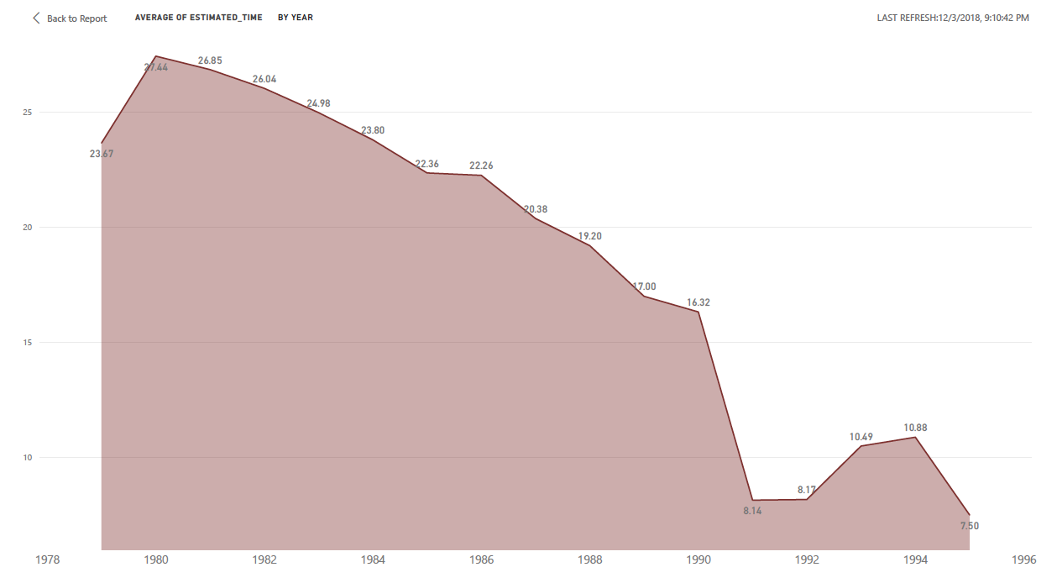
Average Estimated time for a patent

Slide 13
GEOGRAPHIC VISUALIZATION

Slide 14
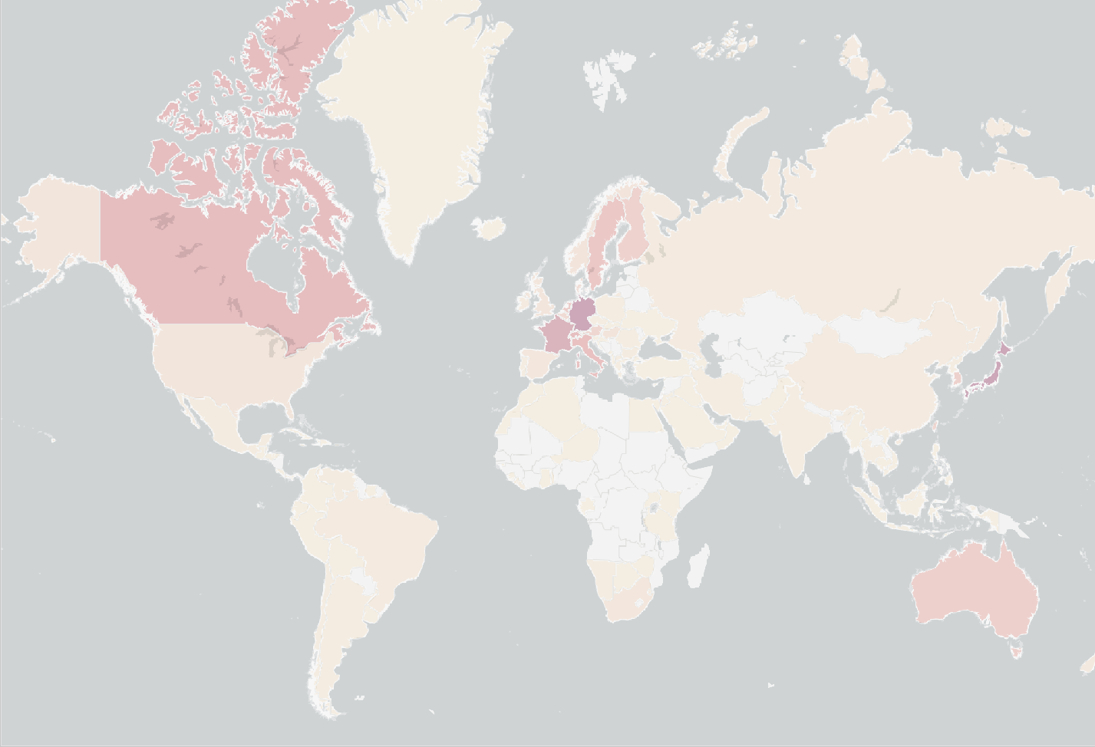

12/4/2018
Total_RfID_Count - Power BI
%GT Total Count of Reel Frame IDS and Max of Total Count of Reel Frame IDS by Country
Max of Total Count of Reel Frame IDS

Country
206103 | JAPAN
69611 | GERMANY
28380 | FRANCE
17671 | ENGLAND
14731 | CANADA
14334 | SWITZERLAND
11360 | ITALY
10451 | STATELESS
8113 | SWEDEN
6050 | NETHERLANDS
4358 | UNITED KINGDOM
3998 | AUSTRALIA
3780 | KOREA REPUBLIC OF
2956 | FINLAND
2454 | TAIWAN
2439 | AUSTRIA
2049 | BELGIUM
1917 | ISRAEL
1841 | DENMARK
1276 | HONG KONG
1038 | HUNGARY
985 | NORWAY
964 | ONTARIO
933 | GREAT BRITAIN
Esri, FAO, NOAA | Esri, FAO, NOAA
876 UNITED STATES
206103
https://app.powerbi.com/groups/me/reports/f96ca50f-a1b5-4e50-966b-fa98a54cbbd0/ReportSection
1/1

Slide 15
Patents Based on Government Interest
This visualization contains the count of reel frame Ids based on the Government interest.
Query:
SELECT COUNT(rf_id), ee_country FROM assignee
WHERE rf_id in (SELECT rf_id FROM assignment_conveyance WHERE convey_ty LIKE "%govern%") AND ee_country NOT LIKE "%NOT PROVIDED%"
GROUP BY ee_country;

Slide 16
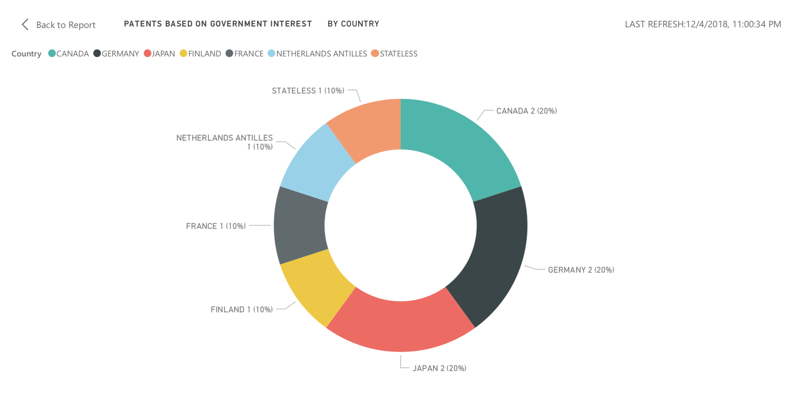
Patents Based on Government Interest

Slide 17
Patents Based on Security
Query:
SELECT COUNT(rf_id), ee_country
FROM assignee
WHERE rf_id in (SELECT rf_id FROM assignment_conveyance WHERE convey_ty LIKE "%security%") AND ee_country NOT LIKE "%NOT PROVIDED%"
GROUP BY ee_country;

Slide 18
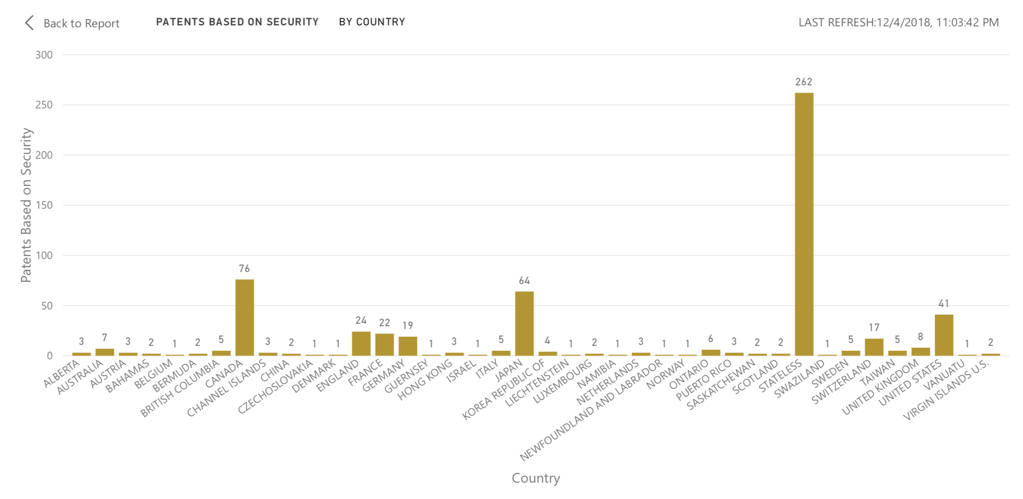
Patents Based on Security

Slide 19
Patents Based on Merger
Query:
SELECT count(rf_id), ee_country FROM assignee
WHERE rf_id in (SELECT rf_id FROM assignment_conveyance WHERE convey_ty like "%merger%") AND ee_country NOT LIKE "%NOT PROVIDED%"
GROUP BY ee_country;

Slide 20
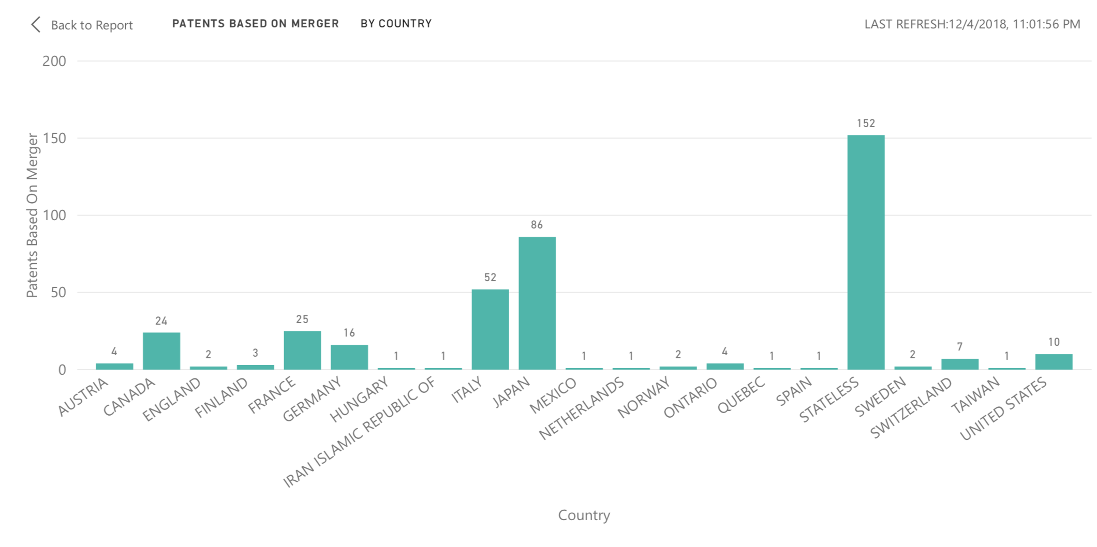
Patents Based on Merger

Slide 21
Correct Patents Assigned
Query:
SELECT count(ee_country), ee_country FROM assignee
WHERE rf_id IN (SELECT rf_id FROM assignment_conveyance WHERE convey_ty like "%correct%") AND ee_country NOT LIKE "%NOT PROVIDED%"
GROUP BY ee_country;

Slide 22
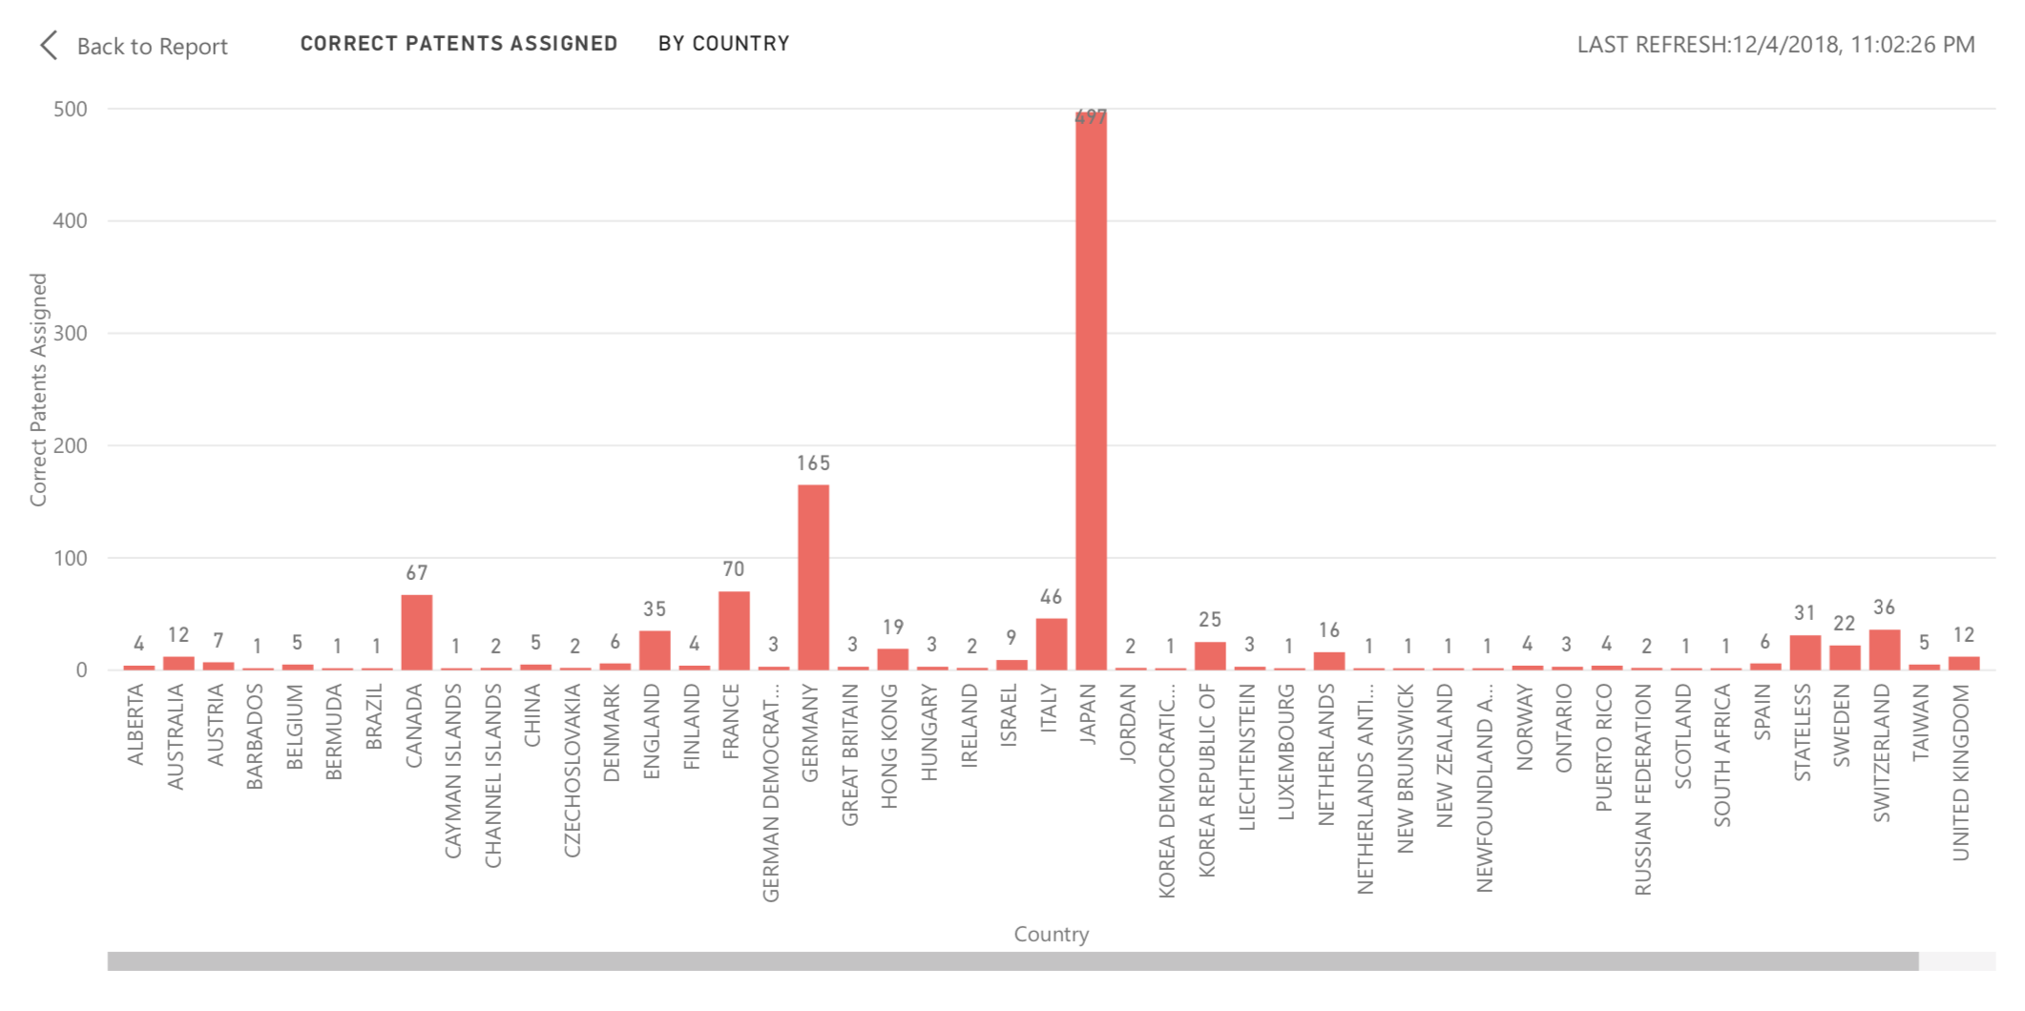
Correct Patents Assigned

Slide 23
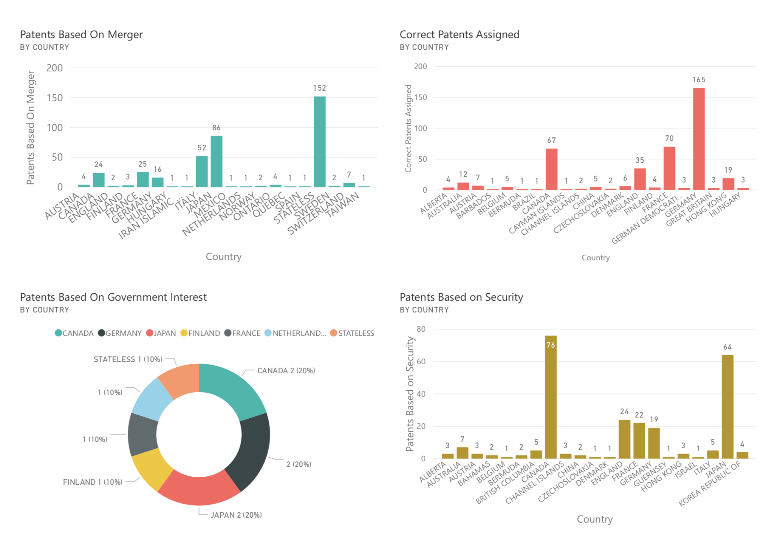
DASHBOARD

Slide 24
ML And Al Related Patents Granted
QUERY:
DROP TABLE IF EXISTS patentcount ;
CREATE EXTERNAL TABLE IF NOT EXISTS patentcount(Title STRING, Count BIGINT) ROW FORMAT DELIMITED FIELDS TERMINATED BY ','LOCATION '/user/dnayak/project4/patentcount';
INSERT INTO TABLE patentcount (title, count) SELECT 'Machine Learning', count(distinct title) as count FROM dnayak.patdesc WHERE title like '%machine learning%';
…..

Slide 25
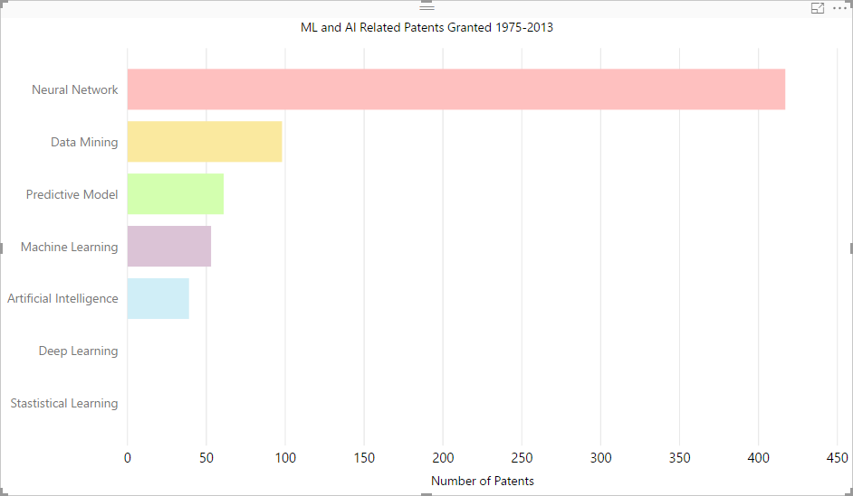
ML And Al Related Patents Granted

Slide 26
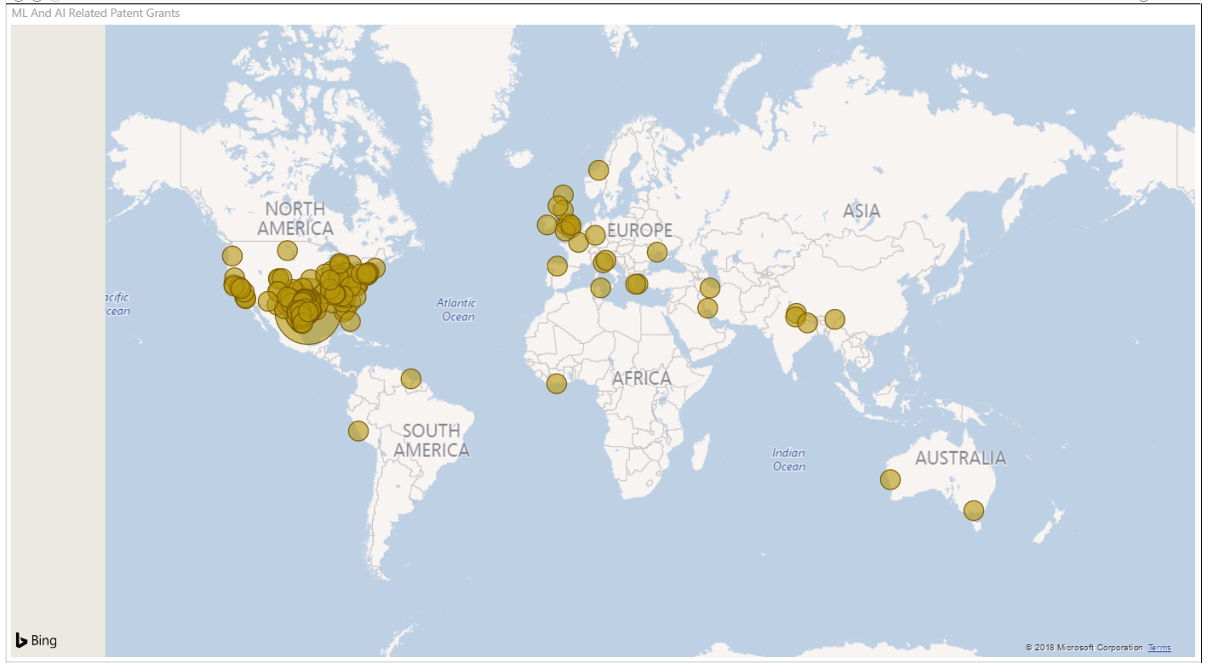
ML and AI Related Patent Grants Where the inventions were made

Slide 27
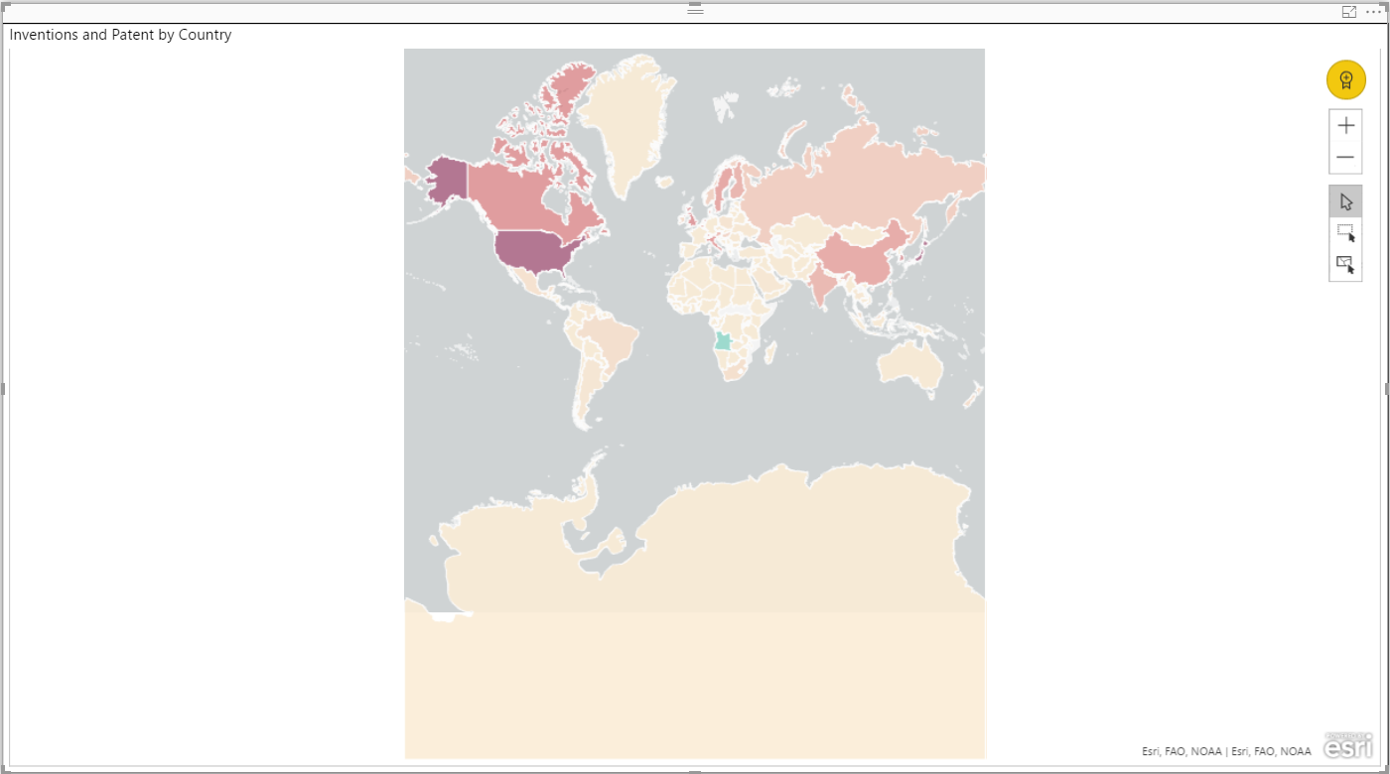
Patents And Inventions by countries

Slide 28
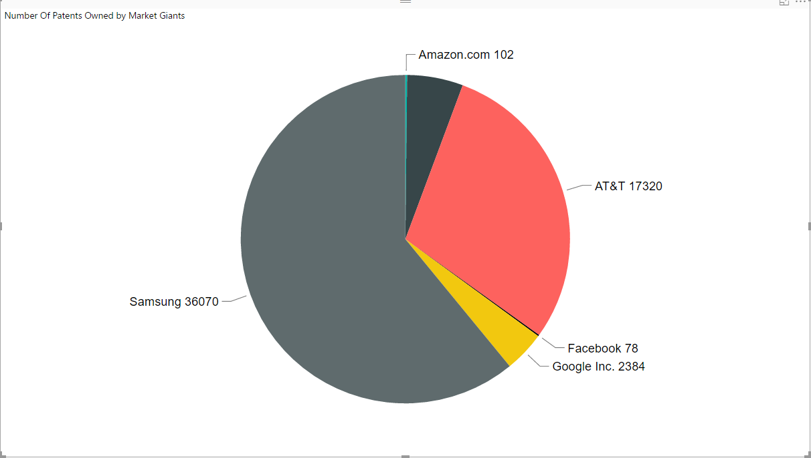
Number of patents Owned by Market Giants (1975-2013)

Slide 29
Factors behind the Rejection of Patents
Rejections are based on three factors:
Missing Application ID
Incorrect Application ID
Ambiguous
Queries Used:
SELECT COUNT(Factors), Factors FROM documented_admin GROUP BY Factors;

Slide 30
LIMITATIONS
Our data has more than 6 million rows which exceeds the limit of excel.
Not having the in-depth details of the patents assigned.

Slide 31
SUMMARY
We have provided a comprehensive description and presented a set of stylized facts to help motivate future research.
Despite some limitations in using these data the Dataset will open multiple avenues for original follow-on research.
Possible areas include the markets for technology and innovation, the relationships of intangible assets to firm financing, and government interest sponsorship to innovation and commercial outcomes.
We encourage researchers to learn from our efforts and these newly-released data in order to answer important questions related to these topics and others we do not have the prescience to predict.

Slide 32
Github Link
https://github.com/asolank5/CIS5200-03-Group4

Slide 33

THANK YOU

